Slide 1
Coral cover assessment in Bantayan Beach

Slide 2
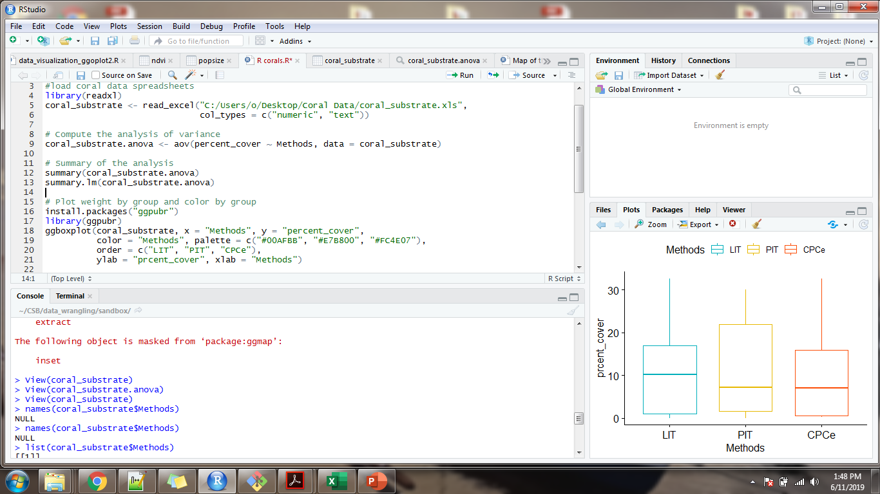

Slide 3
Summary(coral_substrate.anova)
Df Sum Sq Mean Sq F value Pr(>F)
Methods 2 19 9.45 0.068 0.934
Residuals 24 3317 138.22

Slide 4
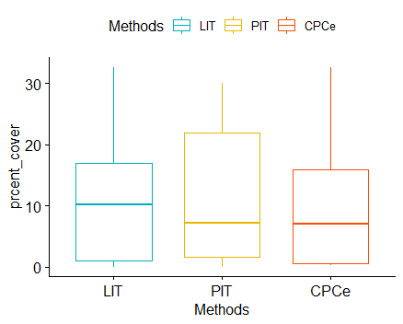

Slide 5


